Slide 1
Egg Industry Conference
29th September 2017
1
By:
Michael Brooks
Executive Director
Egg Producers Federation of New Zealand

Slide 2
Vision for the Future
2
NZ Egg Industry has the opportunity to present a vision to New Zealanders of a united, forward thinking industry.
Quality practices, accredited proof, transparency, empowered consumers.
Food safety

Slide 3
Four pillars of the programme
3
Animal welfare
Food safety
Biosecurity
Traceability
Healthy hens
Healthy eggs
Happy consumers
Healthy farms
Image credit: Murray McMurray Hatchery, US.

Slide 4
An independently-audited quality programme
4
The Concept:
Independently audited verification of farmers and their eggs.
Combination of regulatory requirements and voluntary, increased auditing.
Quality mark visible on packs and traceable, coded marking on eggs.
Dictated by a set of Standards.
Easy-to-understand information is easily accessed through website resource.

Slide 5
Desired outcomes
5
Greater transparency
Helping consumers to understand New Zealand egg farming practices
Quality practices: the industry upholds regulatory requirements to a high standard
Empowering consumers: helping them to make informed purchasing decisions
Increased engagement:
Communications resources to help further educate kiwis about egg farming in NZ
A quality assurance programme that consumers/purchasers can trust when they buy accredited eggs

Slide 6
How have we developed the Programme
6
The UK Lion Mark – a good baseline
A Board working group – developed the Standards to underpin the programme
Key stakeholders, suppliers and farmers – consulted

Slide 7
Traceability
7
Recommendation – Mass Balance Audits
                – Egg Stamping
                Supermarkets / Retail NZ / Commerce Commission / MPI
                Stamping on farm all production types

Slide 8
The Stamping Code
8
EPF Provides 3-digit alpha codes – done
International number system
  0 = Organic
  1 = Free Range
  2 = Barn
  3 = Cage
  4 = Colony (NZ Addition)
  Listed on-line

Slide 9
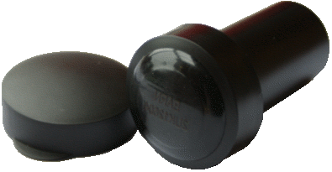

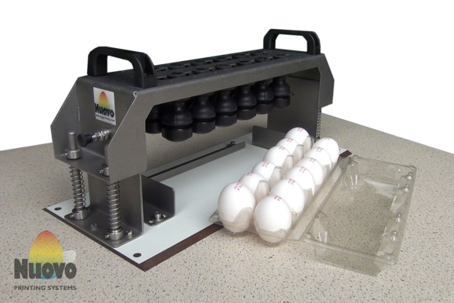
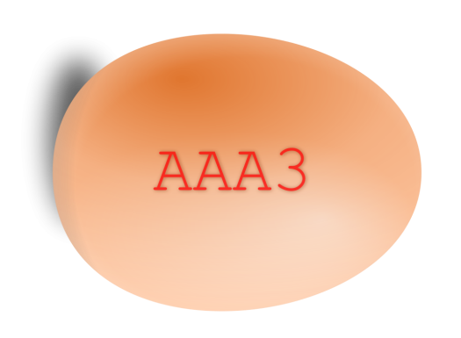
How to stamp?
9
Notes:
hand stamp
Doz. egg hand stamp
30 egg hand stamp
Machine Stamp – including grader integration
Machine Ink Jet – including grader integration
Stamp can be anywhere on the egg, so long as it is LEGIBLE and VISIBLE

Slide 10






What goes on the egg?
10
Only food grade ink is acceptable. Red, pink, green and blue.
Applied by stamping or ink-jetting
3-digit alpha code = the farm
Optional: additional information / images AFTER this code
International numerical code = production method
Notes:
As per slide text

Slide 11
11
INFORMATION
Website – Mobile Friendly
www.trackmyegg.nz
Check farm origin farm type
Farmers make own choice as to level of information

Slide 12
12
Egg Stamping
Sign up forms available
Farmer information packs
Suppliers ready for you to be in touch
Farm ID available

Slide 13
Timeline
13
2018 > Phase 1: Egg Stamping Launched
2019 > Phase 2: Full QA programme launched
2020 > Phase 3: Aim – all farmers accredited

Slide 14
Q A Programme
14
Farmer feed back
Non duplication of audits
One stop shop for QA audit

Slide 15
Free Range Definition
15
Not in Welfare Code
EPF endorsement at Code Criteria
Support from farmers, MPI, Commerce Commission, Supermarkets

Slide 16
What is New Zealand Free Range?
16
To be classified as Free-Range by the Layer Hens Code of Welfare 2012, farms should regularly maintain and be audited to meet the following core standards:
Barns: Provide secure weather- and pest-proof housing for the birds and give access to the outdoors.

Slide 17
17
Maximum indoor/outdoor stocking densities: Indoor 9 hens/m2, and outdoor 2,500 hens/ha.
Food & Water: Adequate quantities of food and water to maintain good health, meet birds’ physiological demands and prevent ill health.

Slide 18
18
Nests & Perches: A minimum of 1m2 / 120 hens for communal nests or 1 nest / 7 hens and at least 15cm of perch space for roosting.
Shelter & Shade: Access to adequate shelter and shade that protects from adverse heat and cold, and offers protection from predators and pests.

Slide 19
19
Lighting: A minimum 8 hours’ continuous darkness per day for the birds.
Housing & Equipment: Designed to allow birds to express natural behaviours, providing adequate ventilation and protection from injury, disease or pests.

Slide 20
20
Range Management Plan: A robust range management plan tailored to that specific farm.
Health & Welfare Plan: A detailed health and welfare plan including daily inspection of birds, regular removal of mortalities and humane treatment of disabled or sick birds.

Slide 21
21
Medication: Use of medication only in accordance with registration conditions, and under veterinary supervision.
Handling & Transportation: Code-mandated handling and transportation.

Slide 22
22
Access to the Range: access during daylight hours and pop holes at least 35cm high and 40 cm wide evenly spread along the shed

Slide 23
Other Topics
23
ESR / MPI Salmonella Study
Government Industry Agreement re Biosecurity
Review of Layer Hen Code

Slide 24
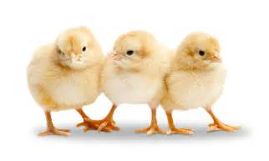
Thank you

