Slide 1
How Changing regulations may affect you
Poul IsRaelson & Anita Simpson
Notes:
Poul Israelson
Technical Director and Senior Planner
Anita Simpson
Principal and Senior Process Engineer

Slide 2
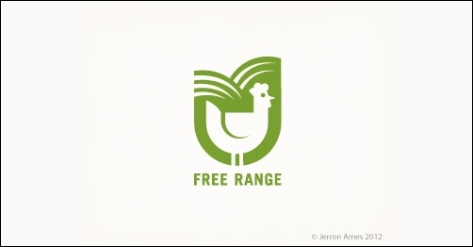
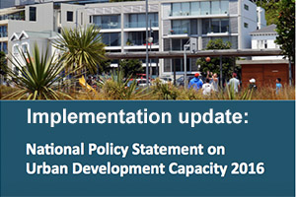
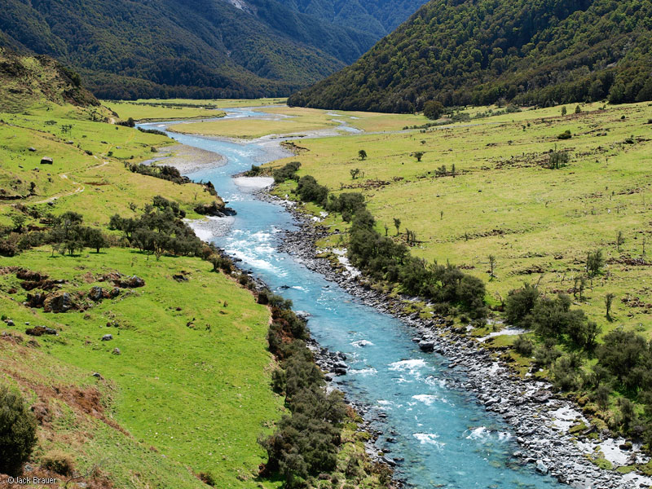
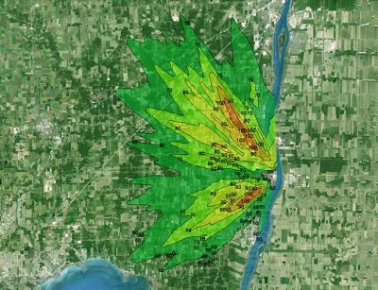
What we will cover
Changes in Market Trends
Planning Regulations
Water
Odour
Notes:
Poul
Changing Market Trends - National animal welfare code and Commercial trends
Planning regulations – National Policy and Environmental Standards – trickle down through to rules in Regional and District Council plans – implications for egg producers – compliance costs and cost of changes to operations
Water
Election implications – potential change in government – implications on water and industry generally
Water and Wastewater – Nutrient loading and wastewater discharge
Odour – Qualitative study of odour complaints of last 10 years – Example of issues.

Slide 3
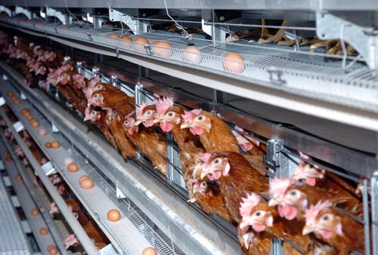
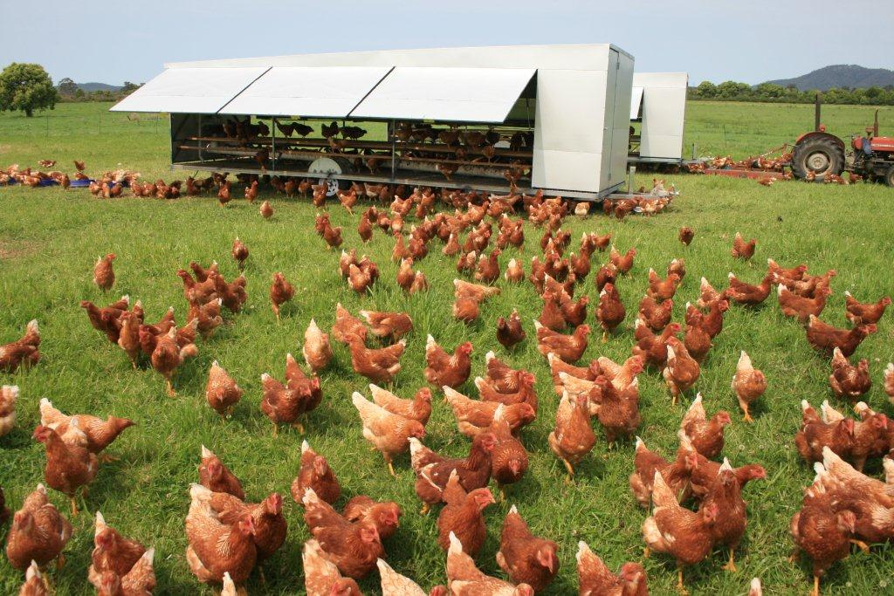

Animal Welfare Code
Notes:
Poul
Animal Welfare Code – Requires the conversion from caged to enriched cage systems. Timeframes:
40% by end of 2018
20% by end of 2020
Final 40% by end of 2022.
The Code will have implications for farmers who choose to continue to operate cage systems. Conversions to enriched cage systems will require changes to shed configuration and generally result in lower stocking densities.
If farmers wish to continue at their current production levels, it is likely that the expansion of existing operations will be required.
Expansion of farms will expose farmers to new consenting requirements in an environment where there are now stricter rules being imposed at both District and Regional Council level. The ability to expand will also be subject to land availability and having appropriate separation distances to neighbours.

Slide 4
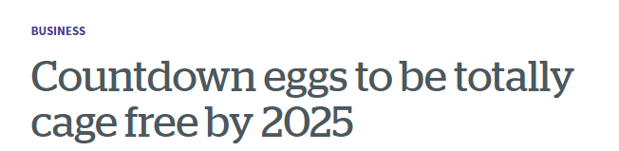
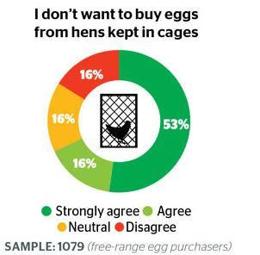


Market Trends
Notes:
Poul
In addition to the changes introduced by the Animal Welfare Code, there have been some recent changes in the commercial landscape – particularly with the type of eggs sold.
Earlier this year Countdown indicated that it will not sell cage eggs by 2025, and just last week, New World followed this trend and has committed to selling non-caged eggs by 2027.
With the requirements of the Animal Welfare Code together with changing market trends, there will be greater likelihood of traditional cage egg operations converting to either to barn or free range operations.
Changes to operations will likely trigger the need for farmers to amend, or obtain new, consents and permits from District and Regional Council’s.

Slide 5
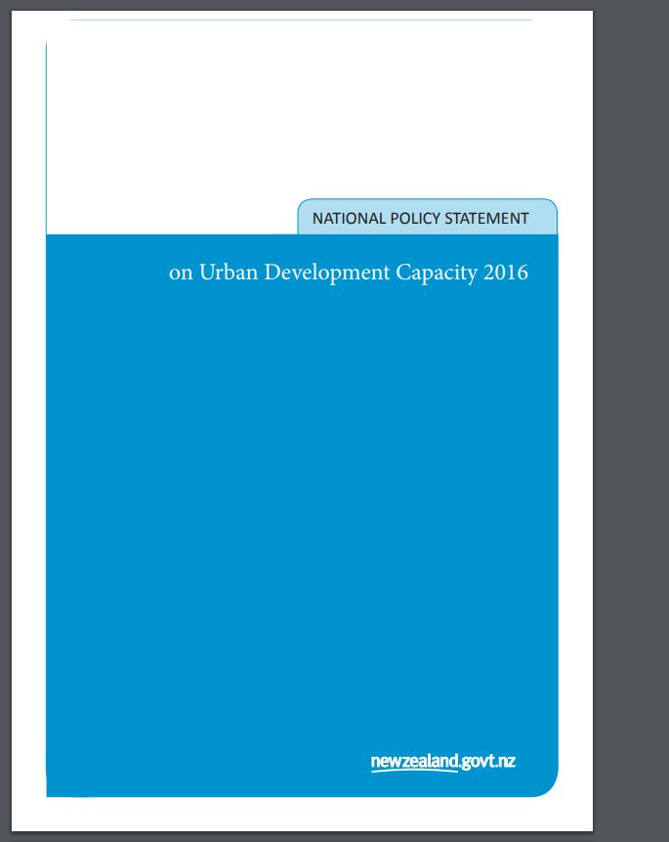
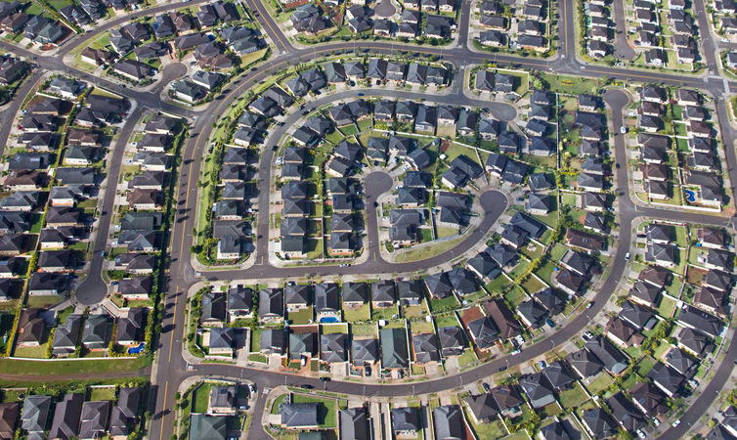
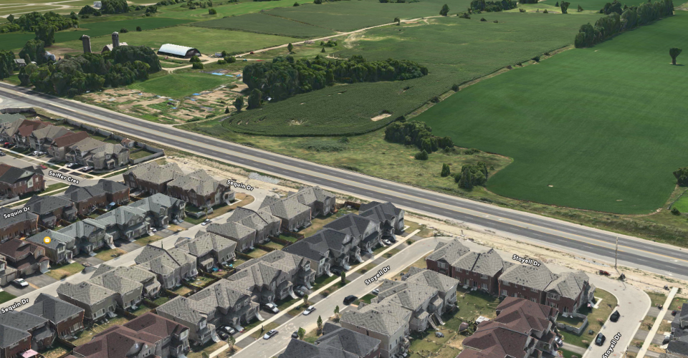
Central Government regulation
Notes:
Poul
There are a number of central government initiatives that has the potential to impact on the poultry industry in general. I would like to outline 2 of these initiatives:
National Policy Statement for Urban Development Capacity; and
National Planning Guidelines
National Policy Statement for Urban Development Capacity
The NPS for UDC provides Councils with direction for the planning of urban environments. The NPS looks to encourage the intensifying “up” and “out” of high growth urban areas. The implications of this policy document is that there is now national direction provided to Councils on how to manage the urban environment, but there is nothing at this stage providing them direction on how they should manage the rural environment. This creates inconsistency in planning rules across different councils.
With urban areas expanding, it is moving the urban interface into to rural areas and closer to primary production activities. There is a greater likelihood of reverse sensitivity effects as a result of new urban growth.
HG has been monitoring changes to District and Regional Plans across NZ and comparing these to the location of existing poultry farms. We have prepared submissions and evidence to Councils on behalf of the industry for over 15 years. Current examples include the New Plymouth Draft District Plan, the Auckland Unitary Plan, and Changes to the Regional Plan in Canterbury.
With central government direction through a NPS for urban development, we are noticing a trend of Councils giving greater consideration and emphasis to urban development versus rural based activities. A good example of this is the recent Environment Court decision in Parakai with DB Chicks. This proposal had good separation to neighbours and no history of complaints until the consent was notified. However, the Court decided to decline the proposal.
National Planning Guidelines
Central Government is seeking consistency with the structure and zone types, including definitions, in District Plans across NZ and have recently introduced the National Planning Guidelines.
The focus of the Guidelines has again been on urban environments, with little consideration of rural sector issues. HG has represented the poultry industry and has been part of a rural sector group that has put forward the position of the rural sector to MFE to promote rural issues.
Key Implication
The key implication of these central government initiatives to the poultry industry is that the conversion of farm operations (to enriched cage systems or to barn or free range) will mean that any new consents will need to take into account the NPS for UDC and potentially the National Planning Guidelines.
Councils will have greater consideration of these documents in their decision making and potentially result in a more difficult consent and approval process with increased information requirements.

Slide 6
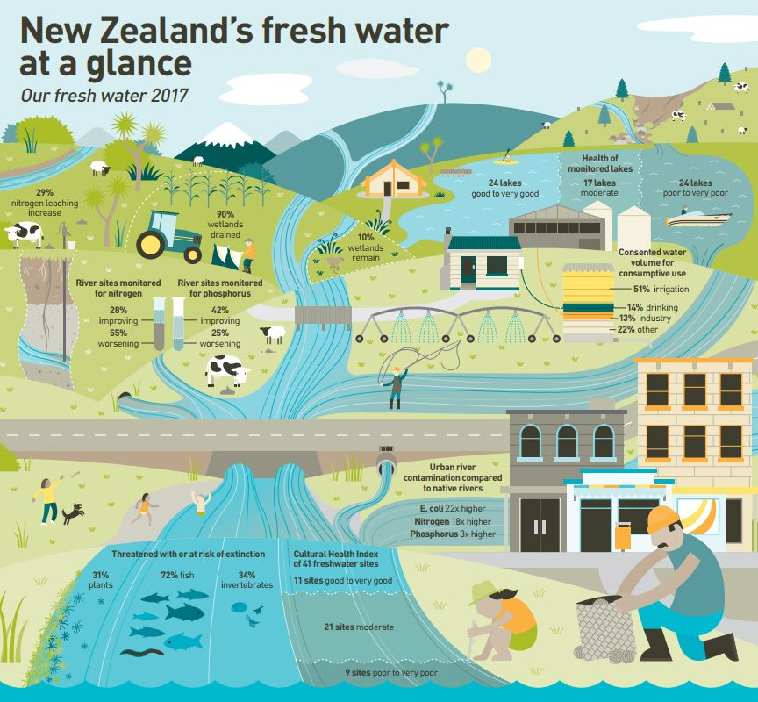
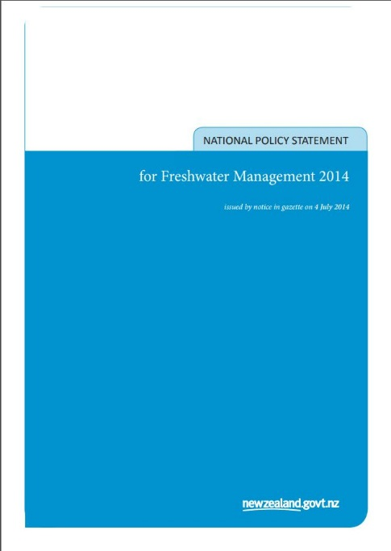
National Policy Statement Fresh Water
“Freshwater quality is maintained or improved”
Notes:
Anita
NPS Freshwater
Purpose is to better manage the freshwater resource (guidance for regional and local government). Targeting:
No increased degradation
Sustainable mgmt. and use of freshwater (improved efficient appropriate allocation)
Protection of significant values of water
Integrated mgmt. (land use/development and water ecosystems)
Plans consistency across Nz – monitoring and mgmt.
Provide for involvement of iwi and hapu (tangata whenua values and interests)
Implications for Poultry Industry
With increased catchment management requirements Regional Council starting to bring new objectives and rules in Regional plan specific for nutrient loading and wastewater discharge.
Poultry industry hasn’t been identified as an industry that generates significant wastewater and nutrient loading historically. For example Environment Canterbury brought in provisions where any discharge on sites greater than 20ha regardless of volume requires discharge consent.
Initial testing from washdown to quantify contaminants and potential loading rates for assessment
Implications can also impact solids disposal that these nutrient loads are considered and need to be included in consents. Including removed off-site – needs to have appropriate consents – enforcement action possible against farm generating the waste as well as receiving.
Rules brought in by Ecan (overseer) and WRC have implications that poultry will now also required consents in this area.
Industry will need to have consistent way to develop and quantify nutrient loading and discharge practices to satisfy rules coming through. This needs to be completed before conversions – otherwise potential to hold up consents. For example – chicken/poultry option in overseer.

Slide 7
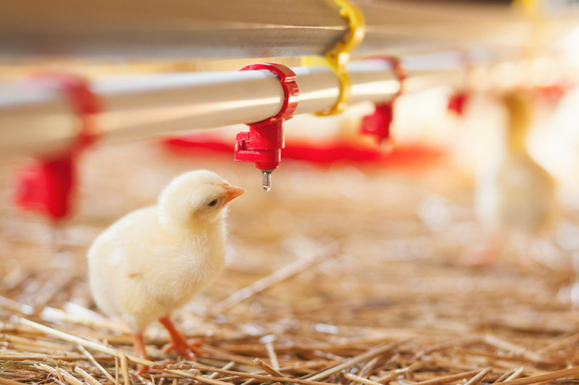

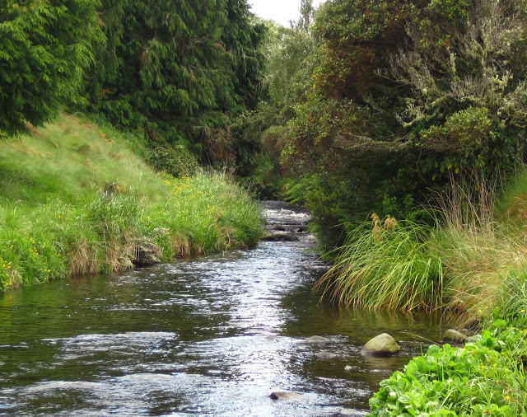
Fresh Water Takes
Notes:
Anita
Key issues:
Charging for water takes (proposed labour policy) – definitely irrigation – potential for stock drinking water – other farming operations – washdown.
1c vs 2c per 1,000 litres – decision to be made in “working group” therefore limited cost certainty
Limitations on water takes (due to historical over allocation) – WRC variation 6 – First come allocation – Expansion into new areas (rural move due to urban sprawl).
Allocations in smaller tributaries limited – groundwater aquifer limitations
Availability and quality

Slide 8
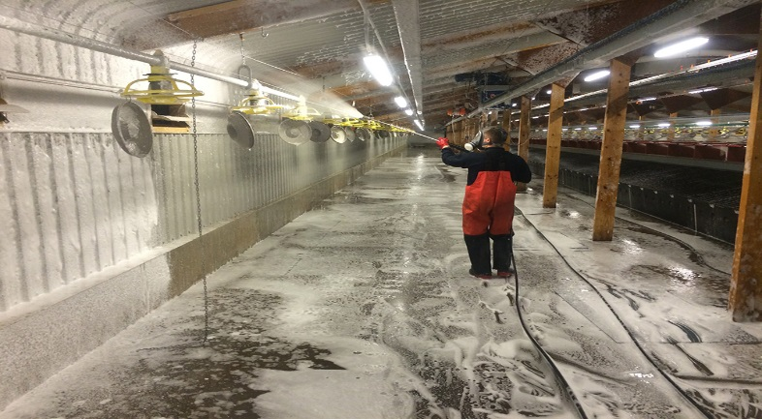
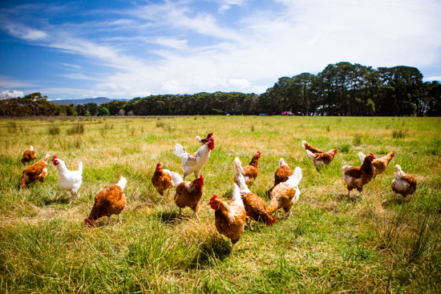
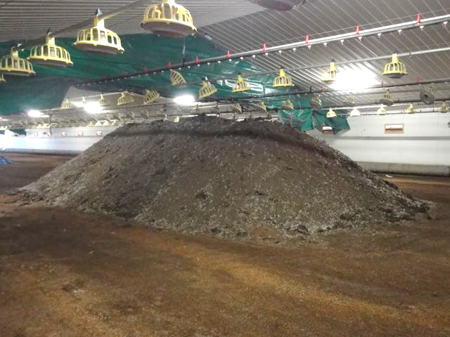
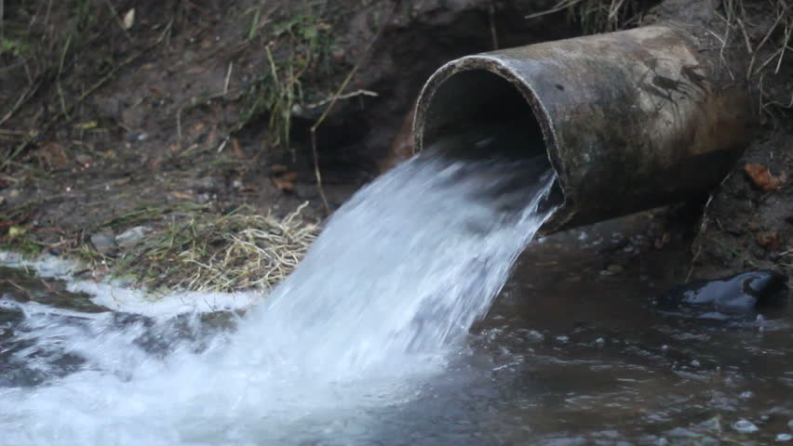
Discharges
Notes:
Anita
Moving from colony to free range – less available space – on current sites. Typically discharged on land surrounding sheds.
Implications are – may not have enough area to discharge volume and also constrained nutrient loads impact. Additionally other solid waste discharges will impact.
Setbacks – spray discharge closer to neighbours – odour source potential – spray health impact
Compliance with existing consents – changes to operations – amendments required
Improving quality requirements (nutrient loadings)
Additional new Green Party policy –”levy on nitrate pollution from agriculture, starting with intensive dairying”

Slide 9
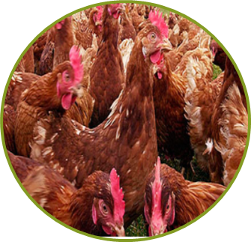
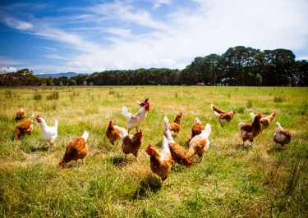
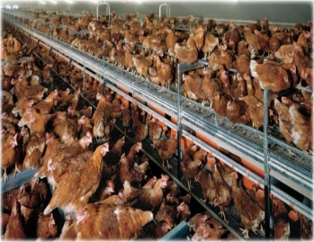
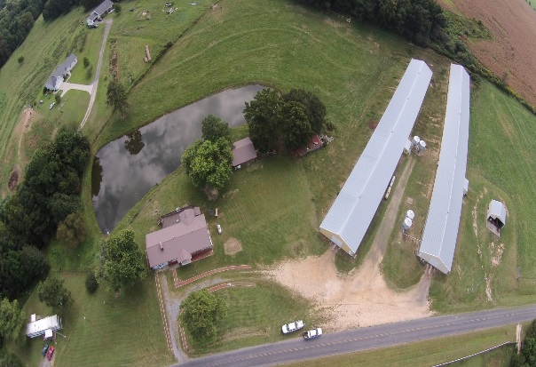

odour and complaints Study
Farm Type
Flock Size
Key Findings
Neighbours
Farm
Separation Distance
Number of Dwellings
Management
Dust
Notes:
Poul
EPFNZ and PIANZ commissioned a study to assess the relationship between poultry farms and air quality effects (odour and dust). The study used complaints data received by Councils throughout NZ from all types of poultry farms over a 10 year period leading up to 2015. Essentially there were no complaints made about dust withthe main source of complaint related to odour.
A total of 450 complaints were received by all councils in NZ over the 10 year period.
Of the 450 complaints, 185 were for layer farms with 121 for indoor and 64 for free range
8 indoor layer farms accounted for 121 complaints and 10 free range layer farms accounted for 64 complaints
Over the 10 year period, 88% of all layer farms did not receive any complaint. This compares to 73% for meat growers.
For layers, the majority of complaints were for indoor layers with a flock size up to 25,000 birds (smaller operators) and the majority of complaints for free range were for a flock size of over 100,000 birds (larger operators).
The likelihood of receiving any complaints from neighbours who were located more than 200m away from the operation decreased significantly.
One indoor farm accounted for 45% of all complaints received for layers. 82 complaints where received but only 9 substantiated by the Council. The farm was a small operator of up to 15,000 birds but had a large number of neighbours located in close proximity. The number of neighbours had increased due to rural lifestyle blocks.
The subject layer farm in the study provides a good example of the pressures that are being placed on the industry with the increased of urban growth. This pressure is expected to increase with the urban policy direction from central government, which filters down to provisions in Regional and District Plans

Slide 10

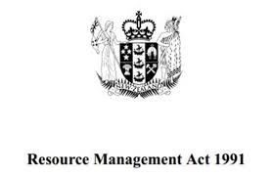
How regulation may affect you
CHANGING REGULATORY CONDITIONS
CHANGING MARKET CONDITIONS
UNCERTAINTY IN CONSENTING
COST UNCERTAINTY
Notes:
In summary
There is an unprecedented period of change in both the market and regulatory conditions that apply to the poultry industry
The changes with lead to an increased likelihood of farm conversions over the next 5-8 years
The regulatory environment with create uncertainty for consenting requirements, with Councils placing greater emphasis on reverse sensitivity effects from urban growth, and water quality and odour management.
The changes to the regulatory environment will create increased cost uncertainty for the industry.

