Slide 1
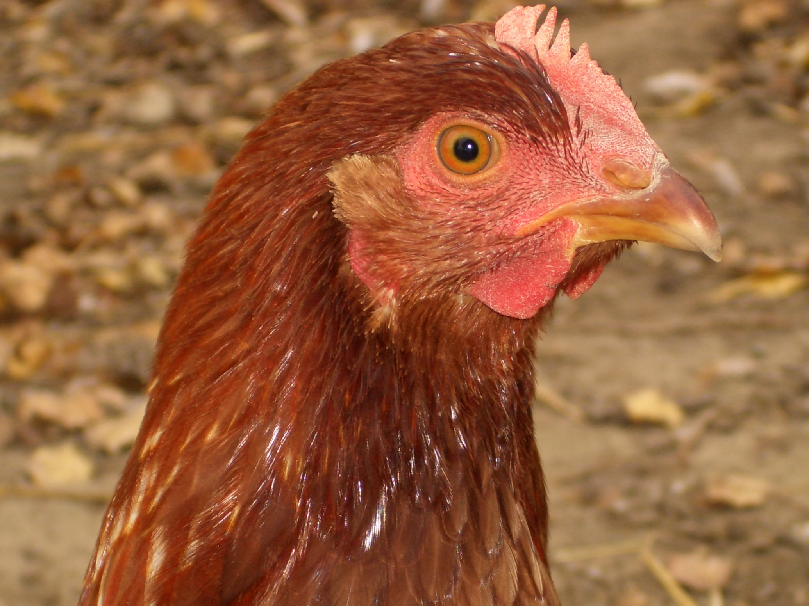
NAWAC
The National Animal Welfare Advisory Committee
Chairperson: Gwyneth Verkerk

Slide 2
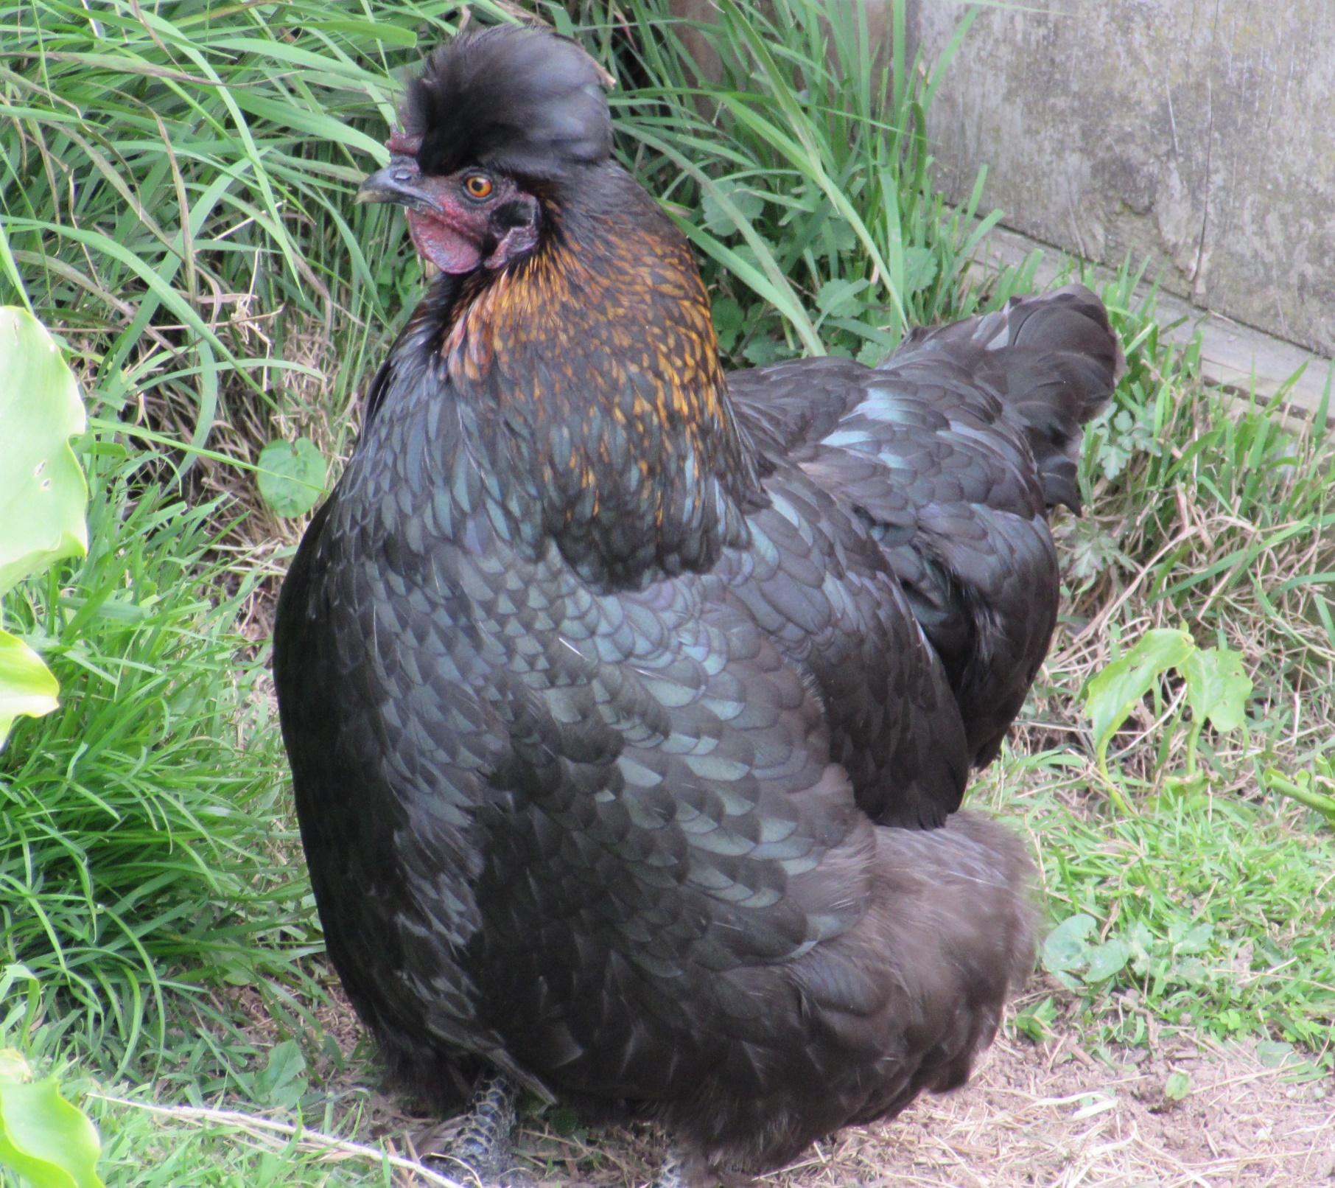
Committee Work

Slide 3

How did NAWAC come about?
  Section 57 of the Animal Welfare Act 1999 – established as an independent advisory committee
  Terms of Reference:
    To advise the Minister on any matter relating to the welfare of animals in NZ
    To make recommendations to the Minister concerning the issue, amendment, suspension, revocation, and review of codes of welfare
  Mechanisms:
    Codes of welfare
    Codes of practice
    Opinion papers

Slide 4
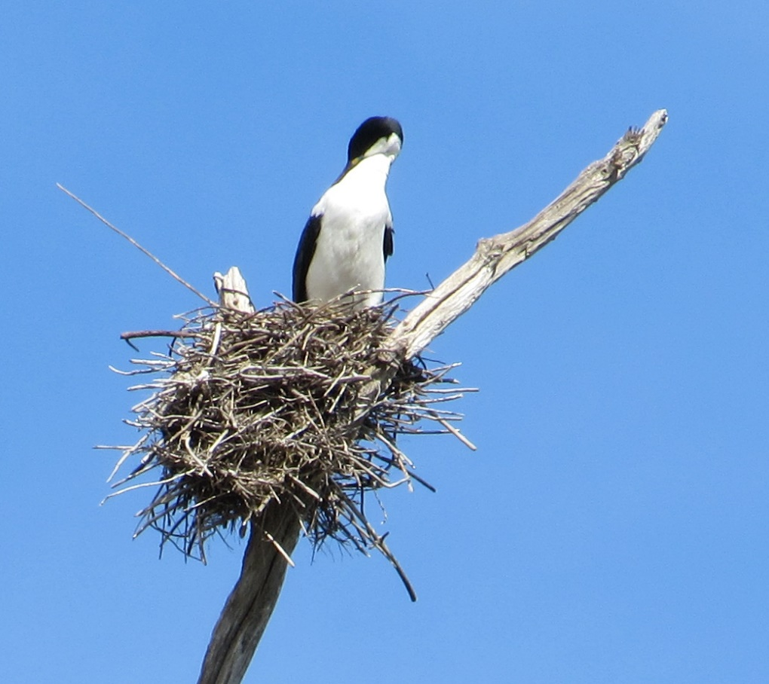
Where is NAWAC in the big picture?
MINISTER
Safe
Guarding
Secretariat
Policy
Compliance
NAWAC
MPI
Verification services
Notes:
Component parts of MPI
Close relationships and maintenance of information flows
The secretariat and its critical role
Also flow of intelligence to assist committee’s annual planning and prioritisation

Slide 5
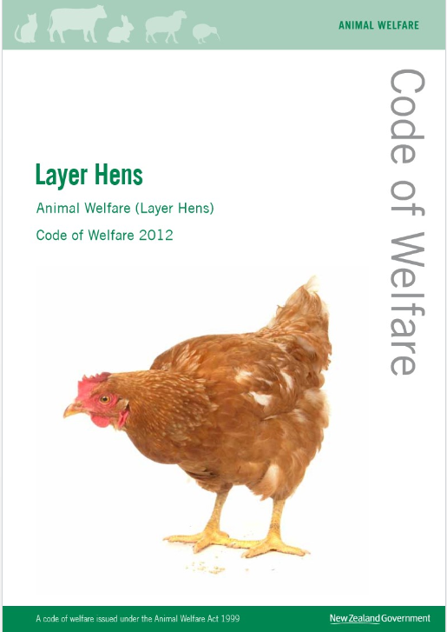
How are codes developed?
      Collaborative process with stakeholders
      Public consultation
      Scientific peer review
      Decision process using Multi-Criteria Decision Analysis matrix

Slide 6
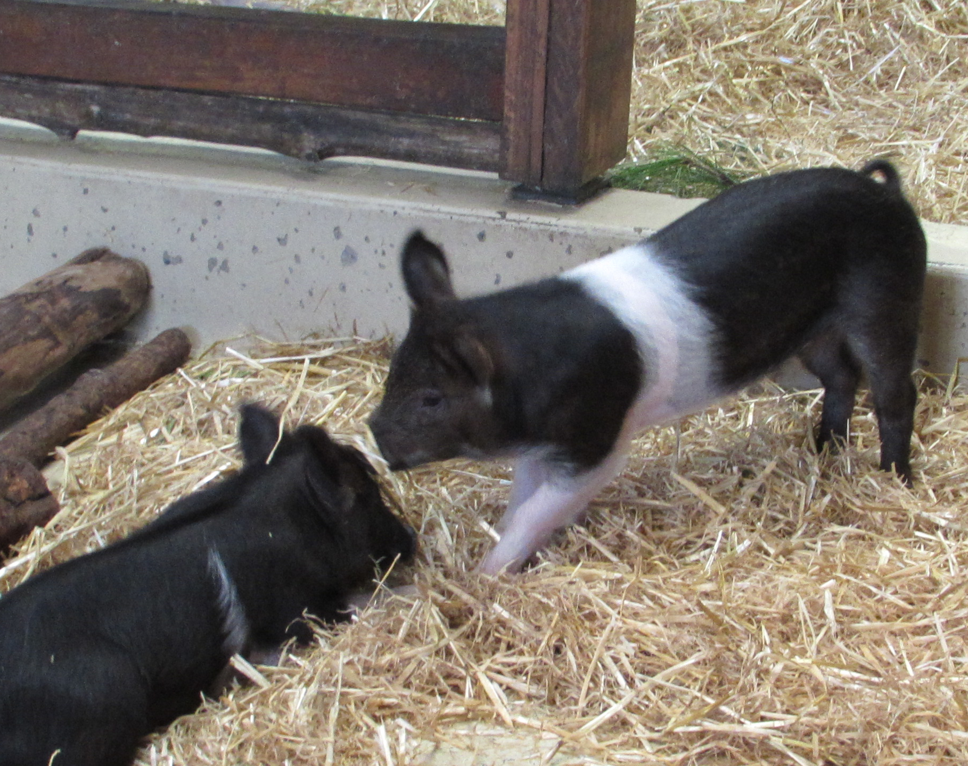
MCDA analysis matrix
 |  | Food and Water | Shelter | Behaviour | Pain Distress | Health | Total
Farrowing crate | Sow | 4.8 | 5 | 2 | 2.6 | 4.2 | 18.6
 | Piglets | 4.4 | 4.6 | 3.6 | 4 | 4 | 20.6
Farrowing pen | Sow | 4.8 | 5 | 3.2 | 3.2 | 4.4 | 20.6
 | Piglets | 4.2 | 4.2 | 3.8 | 4 | 4 | 20.2
Outdoor farrowing | Sow | 4 | 3.8 | 4.4 | 4.2 | 3.6 | 20.0
 | Piglets | 3.4 | 2.8 | 3.6 | 3.2 | 3 | 16.0
Indoor group farrowing | Sow | 4.2 | 4.6 | 3.6 | 4 | 3.8 | 20.2
 | Piglets | 3.4 | 3.8 | 3.6 | 3.6 | 3.4 | 17.8

Slide 7
How are codes developed?
          Code – describes Minimum Standards, Recommended Best Practice, and General Information
          Code Report - describes the issues considered during consultation, and why particular, especially controversial, decisions were made

Slide 8
What must NAWAC consider?
  Scientific understanding of animals’ needs
  Practical experience and available technology
  Good practice
  Practicality of making changes
  International trends
  Societal ethical concerns
  Economic implications
  Religious and cultural practices, and
  Whether any adverse animal welfare outcomes are reasonable or necessary

Slide 9
What happens then?
  Code recommended to the Minister
  Policy process – now includes consideration for regulations
  Legal process
  Code issued by the Minister for Primary Industries
  Dissemination of code

Slide 10
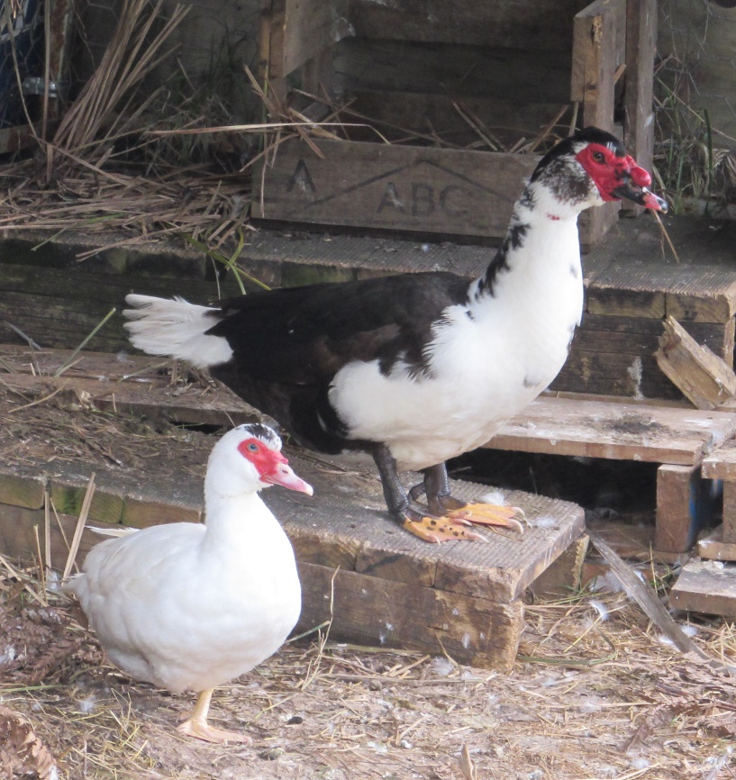
Who is on the Committee?
  Appointed by the Minister
  Up to 10 ordinary members plus chair
  Required to possess knowledge and experience in a range of areas including:
      Veterinary, agricultural and animal science
      The commercial uses of animals
      Care breeding and management of companion animals
      Ethical standards and conduct in respect of animals
      Animal welfare advocacy
      The public interest in respect of animals
      Environmental and conservation management

Slide 11
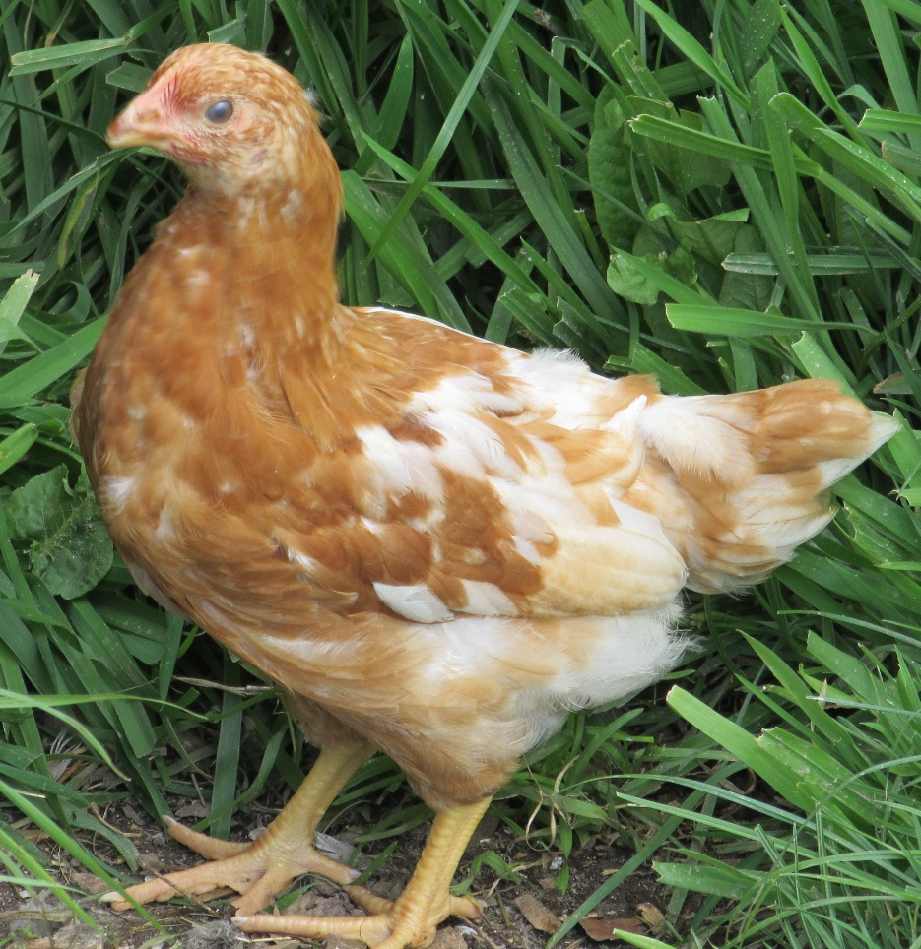
How does the committee work?
  Quarterly meetings of the full committee
  Work done by subcommittees
    3-4 members
    Critical input from Secretariat, especially in science advisory role
  Annual workplan
    Reviewed each November
    Framework to determine high priority issues
    Animal welfare impact score (number affected x welfare impact)
  Breeding
  Codes Review
  Dairy cattle
  Animal sentience and the ‘Good Life’ concept
  Fitness and health of the AW system
  Implementation of standards
  Layer hens interpretation
  Exhibition, entertainment and encounter
  Regulations
  Temporary housing – companion animals
  Wildlife

Slide 12
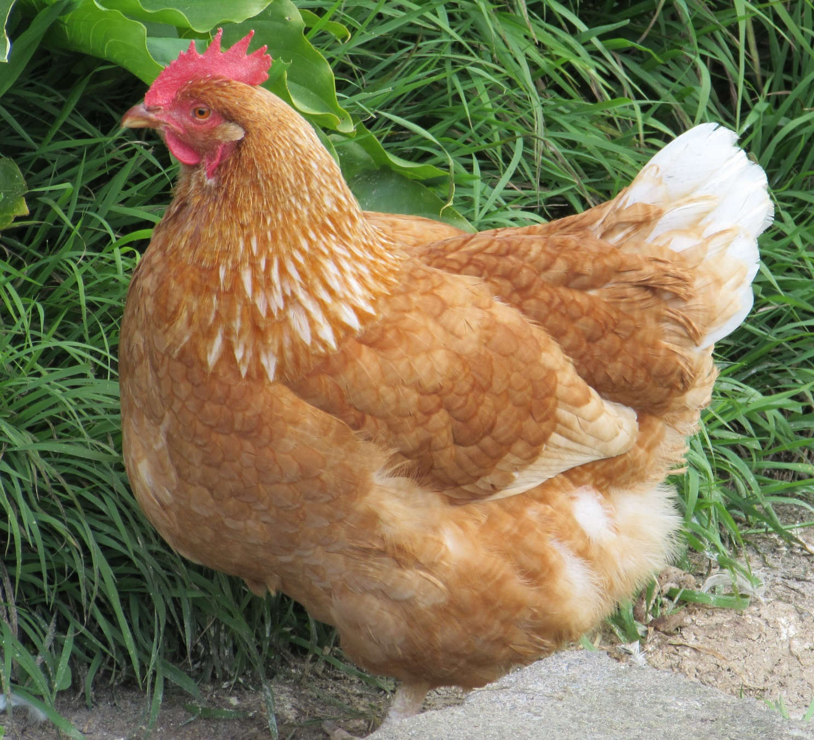
Future challenges
Implementing the 2015 Amendment

Slide 13
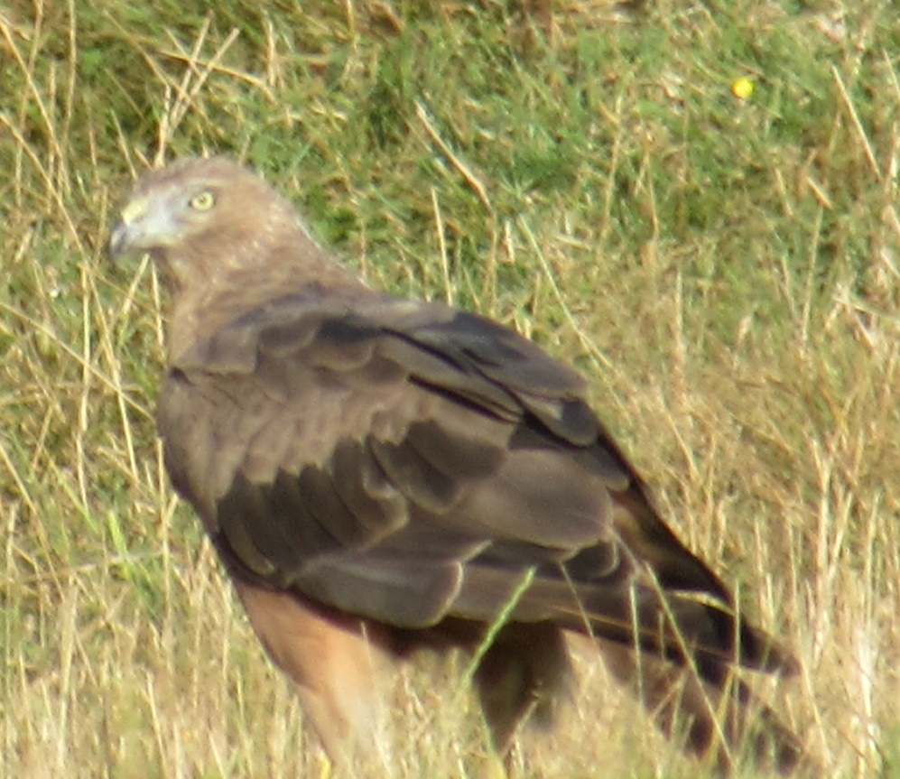
The Introduction of Regulations
  From compliance and policy/legal perspectives:
    Many minimum standards in codes are imprecise so not enforceable
… appropriate … adequate … sufficient …
    Prosecutions based on “cruelty” charges
    No opportunity for e.g. fines for lower level breaches
    MPI Policy:
    Initial focus - regulations for bobby calves (2015)
    Minimum Standards reviewed for adaptation to regulations (approx 200)
    Public consultation of 85 possible new regulations (early 2016)
    Completed work on 46 in August 2017

Slide 14
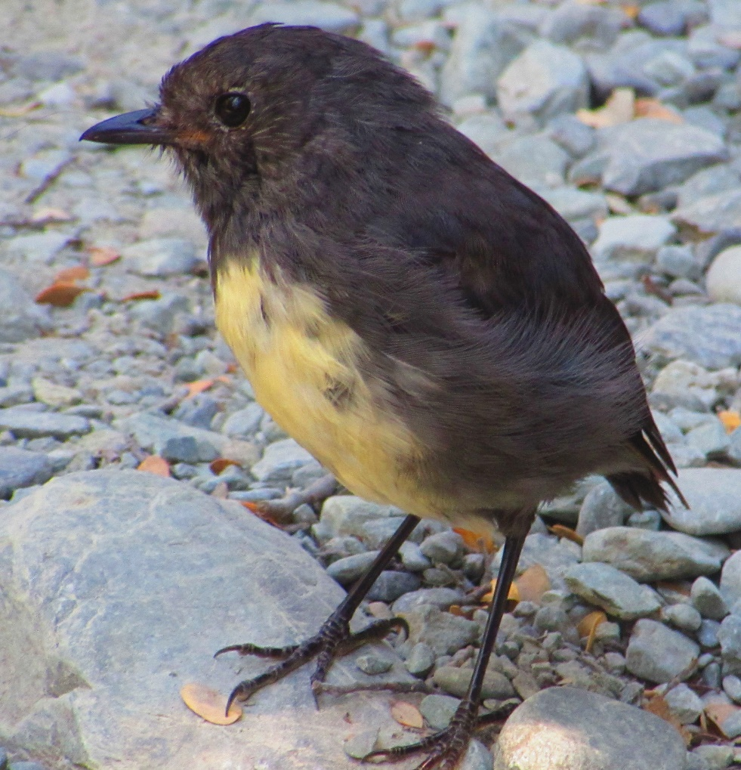
Relevant to you…
Proposed to commence October 2018:
Transitional dates to prohibit the use of conventional cages
Prohibit induced moulting
                Working group in 2018:
                Stocking densities
                Housing and equipment design
                Further code review

Slide 15

Sentience
An animal’s ability to have feelings,
perceptions and experience that matter to it
Animals experience both positive and negative emotions
Do animals need more opportunities for positive experiences?
i.e. undertake behaviours that they find rewarding?
The Good Life Concept
“A life worth living”

Slide 16
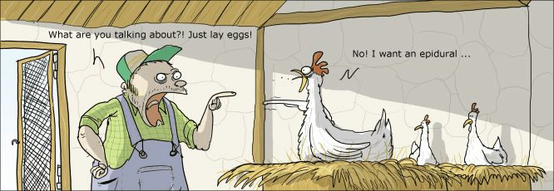

Slide 17
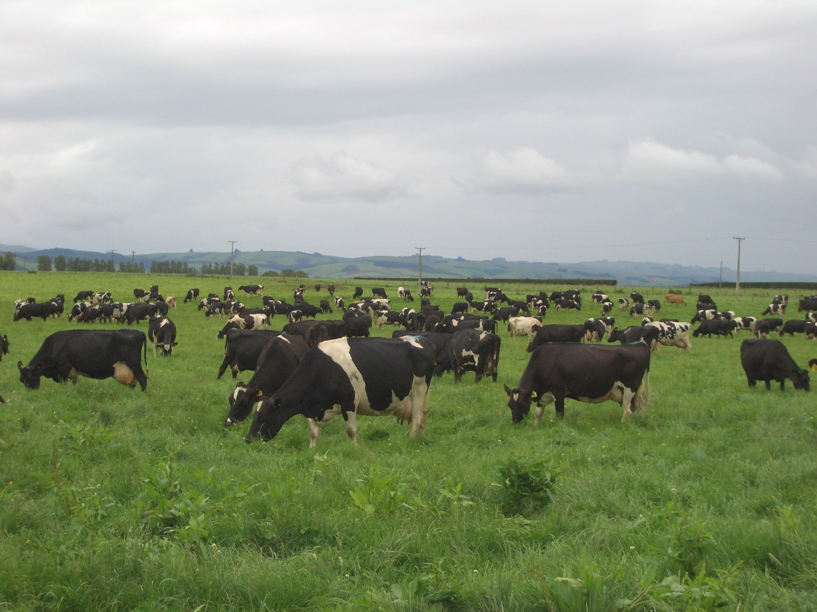
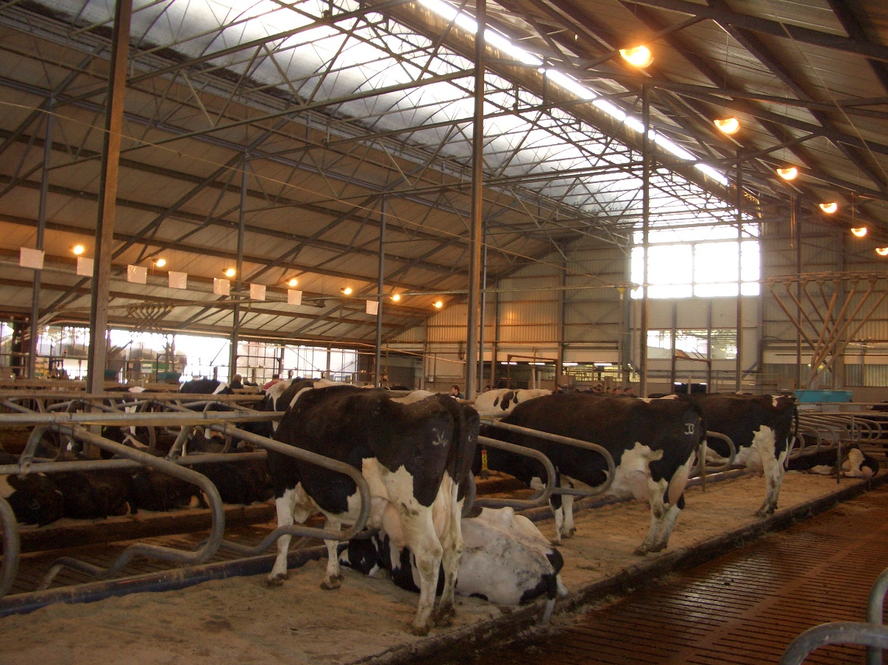

Slide 18

Implications
Assessment Frameworks:
Five Freedoms (1965): “freedom from hunger or thirst, discomfort (shelter), pain, injury or disease, fear and distress, and freedom to perform (most) natural behaviours”
Five Domains Model (David Mellor, 2016)
Domains |  | Scale of delivery
Physical | Environment
 | Nutrition
 | Health
 | Behaviour
Mental | Affective state
0
Negative
Positive

Slide 19
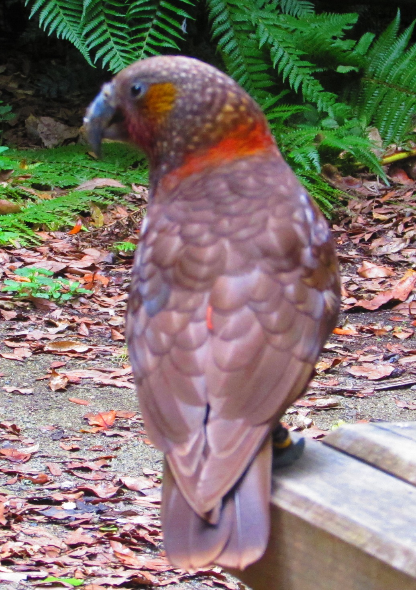
Challenges for us all!!
For NAWAC:
  How do we acknowledge sentience as we review codes?
  How does this affect our industry stakeholders?
  Does the animal become a stakeholder?
  Stakeholder workshop in November 2017
Relevant to you…
  Increasing consumer awareness of ‘quality of life”
  Demand for production animals to have (had) a “Good Life”
  Can we show that the hens on your farms have “a life worth living”?

Slide 20
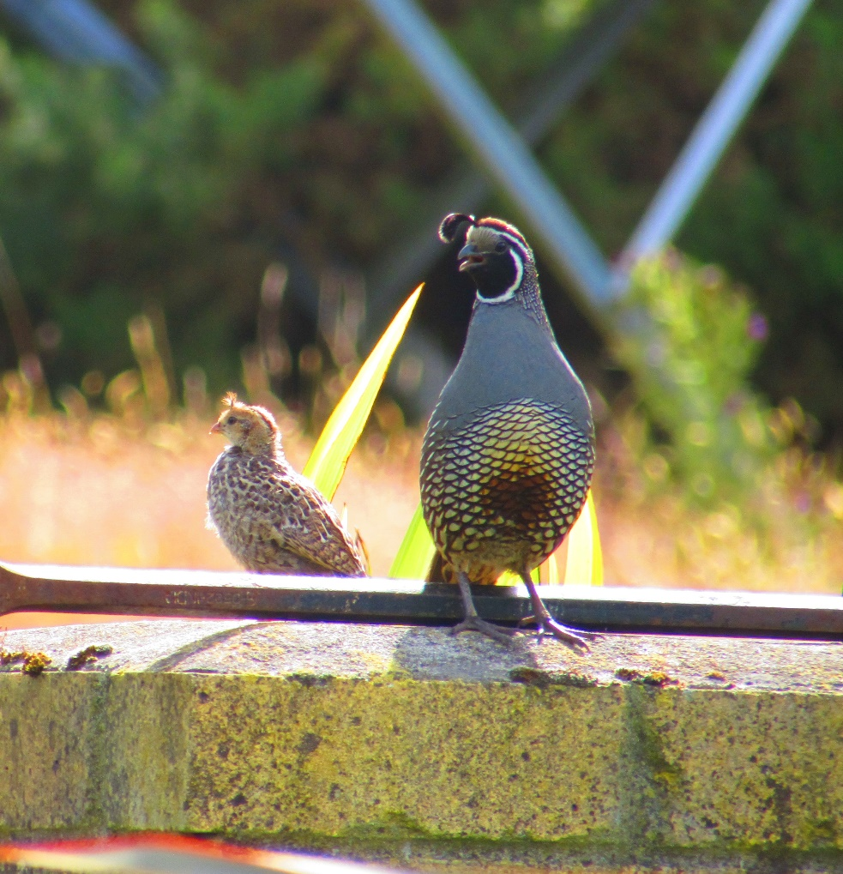
Future code reviews
Amendment now allows partial reviews, i.e. of a section of standard
2005 … 2012 ….
At next review: New Minimum Standard that young birds are to be raised in the system that they will be farmed

Slide 21

Thank you for listening – Questions please?

