Slide 1
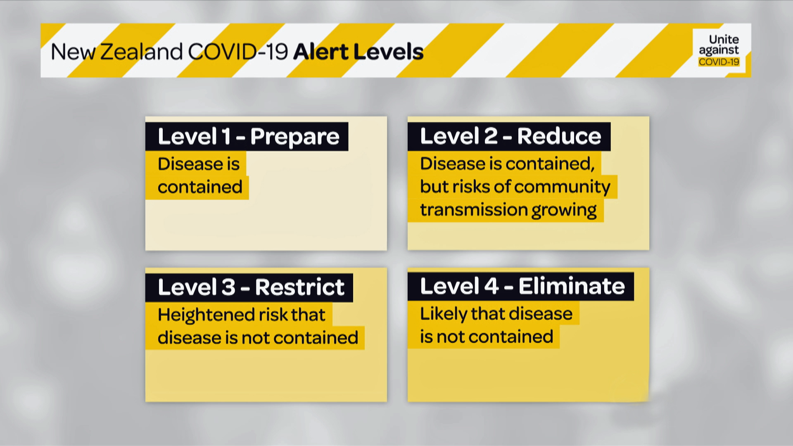

FMCG Forward Planning
Covid-19 Response
7 April 2020

Slide 2
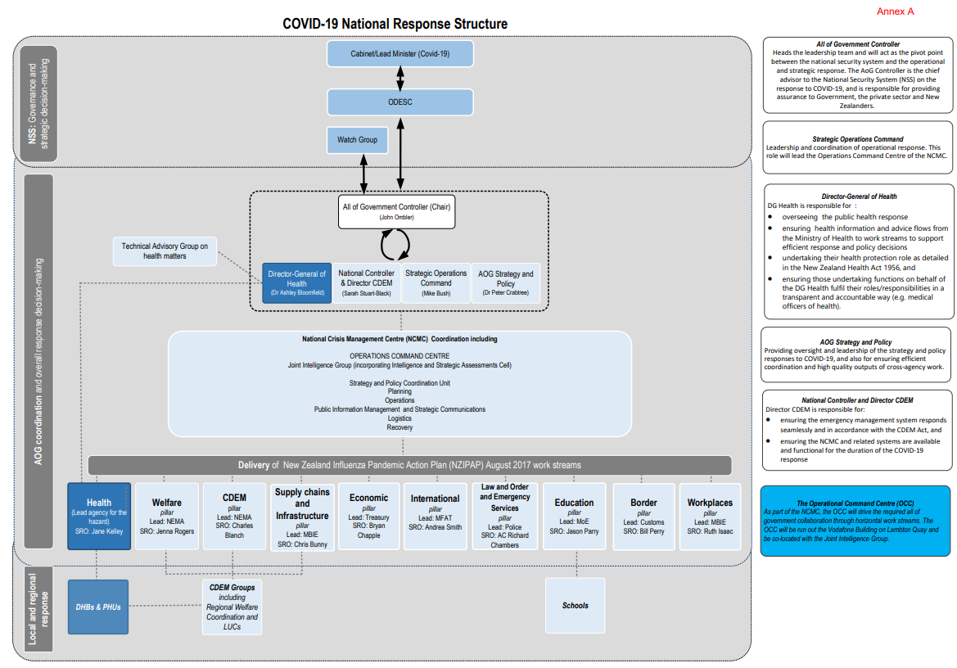
All of Government Response
Source: https://www.parliament.nz/resource/en-NZ/52SCEP_EVI_96420_EP18/1b89a81ce848cbeb471631b68c878304e70b3dc2
FMCG sits under here

Slide 3
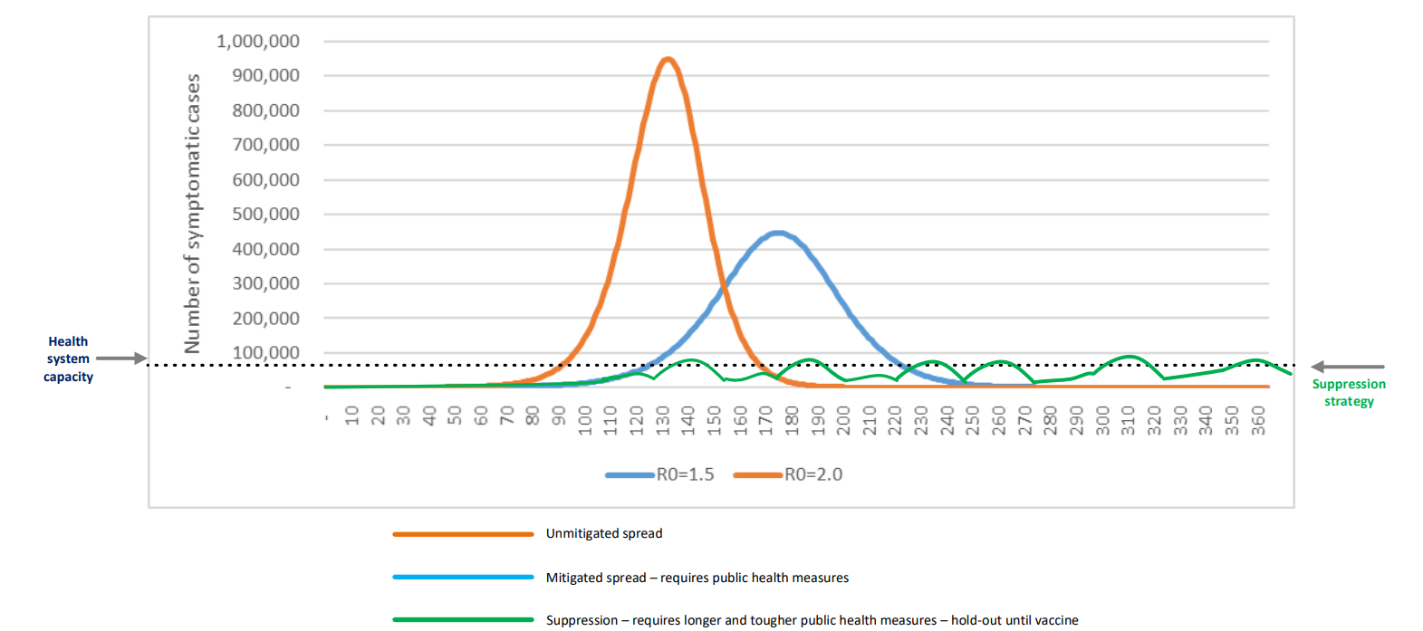
Government’s Current Strategy – at Level 4.
Source: https://www.parliament.nz/resource/en-NZ/52SCEP_EVI_96420_EP18/1b89a81ce848cbeb471631b68c878304e70b3dc2

Slide 4
25 April onwards – medium-term planning (1-3 months)
Suggested scenarios (not official)
Scenario 1: There is a phased transition between Alert Levels (down and/or up), potentially with limited forewarning, over the coming weeks and months.
  Scenario 1A: Reduction to Level 3 either Nationally or specific regions, being ready to move back to level 4 or to level 2.
Scenario 2 : The Alert Level 4 (AL4) shutdown is extended beyond the initial four-week period (either nationally for specific regions)
For more information on Alert levels: https://covid19.govt.nz/alert-system/covid-19-alert-system/
Notes:
Note scenarios 1B, 1C and 1D (level 2 and 1 and out altogether will come later)

Slide 5
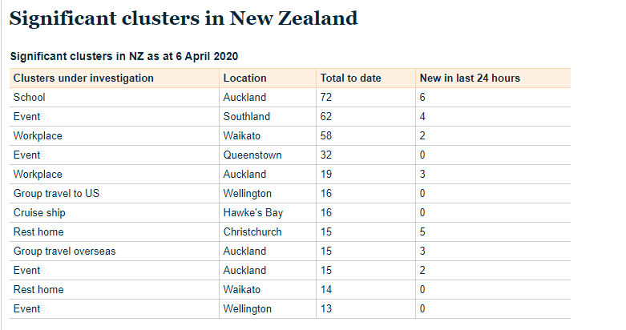
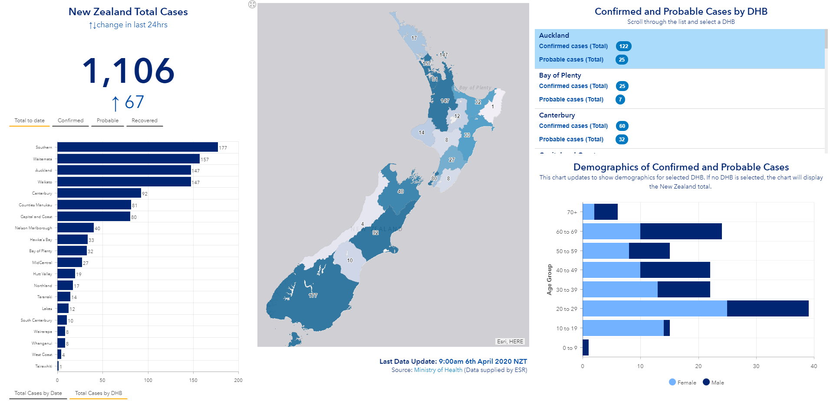
MOH Dashboard: https://experience.arcgis.com/experience/e4e58e39a0ec410eb054f42012a27b4b
Clusters: https://www.health.govt.nz/our-work/diseases-and-conditions/covid-19-novel-coronavirus/covid-19-current-situation/covid-19-current-cases/covid-19-clusters
Notes:
Why Both Scenarios?

Slide 6
Level 3 – draft planning assumptions
Scenario 1A
Workers remain working from home where possible (alternative ways of working required and some non-essential businesses should stay close)
Travel in areas with clusters or community transmission limited
Outside the home the 2 m distancing rule still applies
Could bounce between level 3 and 4.
No schools or childcare (even for essential workers??) - (Affected educational facilities closed).
Public venues closed (i.e. libraries, museums, cinemas, food courts, gyms, pools, amusement parks)
Mass gatherings cancelled
Non-essential business could open if they can meet the strict level 3 MOH mitigations.

Slide 7
Level 3 - Questions
Scenario 1A
Does this change what is essential? (seasonal variations) what does this look like?
What impact does the no schools and childcare have on your workforce?
What types of businesses would still not be able to meet the MOH workplace requirements?
  and what is the impact on the FMCG supply chain,
  future ability to reopen these businesses,
  and their business ability to survive?
Do your workers use public transport, how will this be managed (Q. with AOG).
Are there key maintenance issues you need to undertake, how will this be undertaken?
Do you have staff working outside the region that commute, if there are regional variations in levels, how will this impact your workforce?
How will you manage adverse events during a level 3, what are the barriers to implementing revised BCP's.
What additional guidance or questions will you have around moving to level 3?

Slide 8
Level 4 – draft planning assumptions
Scenario 2
Existing level 4 requirements remain in place:
  People instructed to continue to stay at home
  Educational facilities remain closed
  Businesses remain closed except for essential services (i.e.: supermarkets, pharmacies, clinics and lifeline utilities)
  Rationing of supplies and requisitioning of facilities as required
  Travel severely limited
  Major reprioritisation of health services
Classification of essential businesses and MOH guidance remains the same (?)

Slide 9
Level 4 - questions
Scenario 2
Does this change what is essential? (i.e. seasonal variations)
Clarity on duration ?
Are there key maintenance issues you need to undertake, can this be undertaken and if so how?
How will you manage adverse events during a level 4, what are the barriers to implementing revised BCP's.
Do you have staff working outside the region that commute, if there are regional variations in levels, how will this impact your workforce?
What additional guidance or questions will you have around staying at level 4?

Slide 10
PPE – FMCG survey
PPE type | User | ~ Usage (per week) | Likely Gaps & timeframes
Masks | i.e. All XX NW stores in North Island… | XXX per week | i.e. gap in volume between your usage and any confirmed secure supply chain for future weeks and which dates supply becomes critical.
Gloves
Sanitiser
Other (state)

Slide 11
Next steps
Consider these assumptions and questions and plan with your members/franchisees for both of these scenarios (likely to be regional mix of levels 3 and 4 with regions of community clusters staying at level 4).
Questions/clarity required – email Covid-19.FMCG@mpi.govt.nz and we can get these raised with the all-of-government planning/policy group.
Additionally if you have major concerns we can capture these and feed them into the all of government planning to help inform decision/policy making.
Return the PPE survey to above email.

Slide 12
